Slide 1
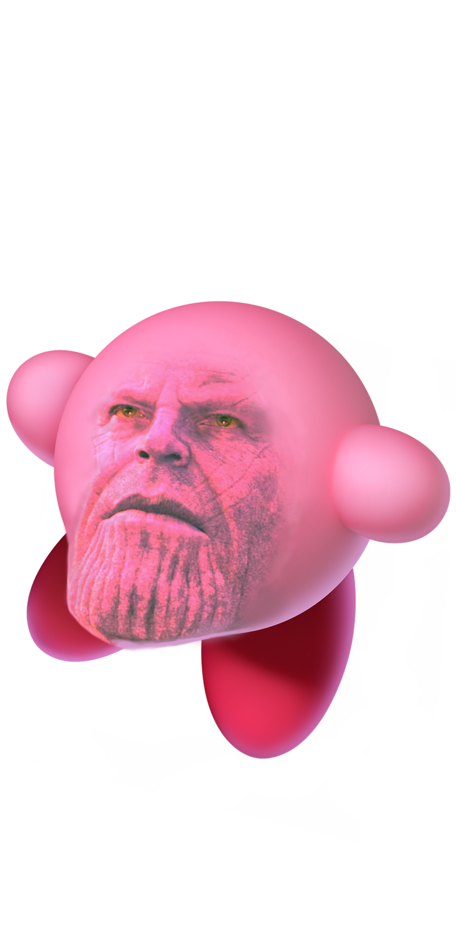

Day 3 – 4:00 Project Progress Report -Tympe-
Logan Schlick, Daniel Marin, Kyle Rimando, Sonny Pizzo, Shane Ghuste

Slide 2

Front end progress…
no further action
Backend practically finished so we can now fine tune and design webpage with no problems
Front end designers:
Daniel Marin
Sonny Pizzo

Slide 3

Back end progress…
Reconstructed backend game from Python to JS
Readjusted existing Python files to accommodate changes
Typing is tighter, enter and tab not necessary
Timer functions with game play while ending the game too
Back end designers:
Logan Schlick
Kyle Rimando

